Slide 1
Carbon accounting on the goodman unit

Slide 2
OVERVIEW
Alternatives of Goodman Unit Management
Carbon Calculations
Carbon Certification
Wood Buildings
Goodman unit area: ~7,700 hectares
Total Carbon:
1.9 million tonnes of Carbon
6 million mega grams of CO2 equivalence

Slide 3
Alternatives of Goodman Unit Management
Hyunju Lee & Luyi Li
Notes:
Straightforward & keep short (too long last week)
Make sure explain each scenario clearly
Ok. We are going to explain 3 alternative of goodman forests management.

Slide 5
Management Scenarios:
Baseline
No Management
Sustainable Forest Management

Slide 6
1. Baseline
 | How much area: 1.5% of Goodman Unit
 | How often: Every 5 years
 | Treatment: Clear-cut, leave 8 (of the largest) tree/acre
 | Total rotation years: 375 years
 | Example: Clear-cut 1.5% of Goodman Unit re-harvest the same stand in the year 2394
Notes:
The first alternative is the Base Line which is currently undergoing at Goodman Unit
How much area: 1.5% of Goodman Unit
Which way: clear cut but leave the largest 8 trees for habitat? Or timber???
How often: every 5 years
Therefore rotation years is 375 years. For reference, Pack forest’s rotation year is 60 years????
The stand cut in 2014 will be cut again in 2394.

Slide 7
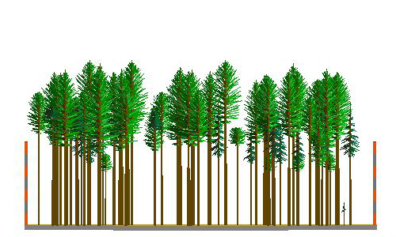
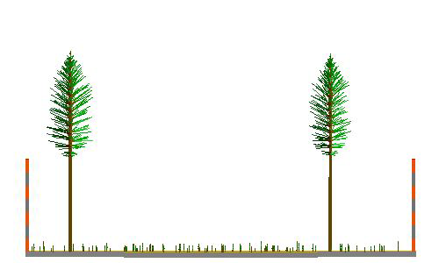
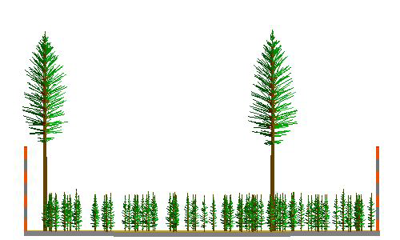
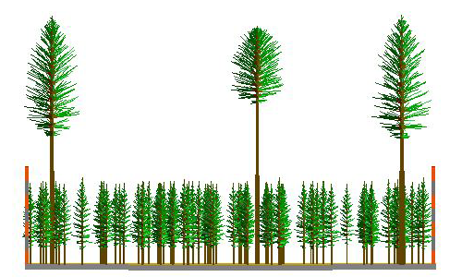
Stand Visualization of Baseline Management, Stand: 21153
2014 | 2024
2034 | 2044
Notes:
These photos show the 1.5% forest condition of which is applied clear cut and left 8 trees/ acre. (As you can see there are 2 big trees left, so this photos show .25 acre of the 1.5% forest which is applied clearcut. )

Slide 8
2. No Management
 | Advantages: Maximize current carbon No costs for plans or managements
 | Disadvantages: No timber value Risk of wind damage
Notes:
We choose this alternative to show you what happens if we do nothing for forest management.

Slide 9
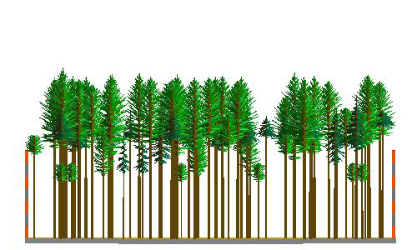
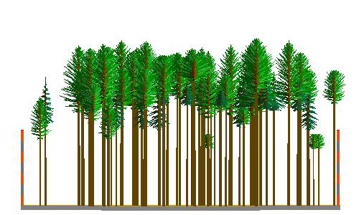
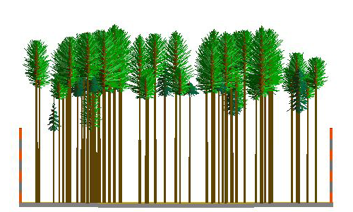
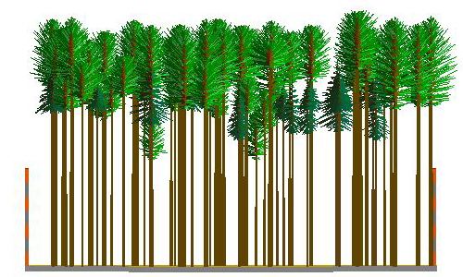
Stand Visualization of No Management, Stand: 21153
2014 | 2024
2034 | 2044
Notes:
As you can see, the forest is getting dense as time passes. The forest has natural thinning treatment by their high dense condition, but still it has lots of small diameter trees compare to treated forests.

Slide 10
3. Sustainable Forest Management
 | How much area: 17% of the Goodman forests
 | How often (interval): Harvest 5-yr, PCT 10-yr
 | Which way: - Harvest 70%, Retain 30% - Re-plant 300 Douglas fir seedlings/acre - Pre-commercial thin in 10 years from harvest (e.g. 1st PCT 2024- 1*10 = 2014, 2nd 2034 - 2*10 = 2024)
*Increased investment as intensive treatment involved.
PCT = Pre-commercial Thin
Notes:
- Leaving 150 TPA
Harvest 70% of the trees, Retain 30% (largest trees
Precommertial thin cut all trees 0 – 8” DBH, this will promote growth in the stand of the planted trees
Leaving 150 TPA

Slide 11
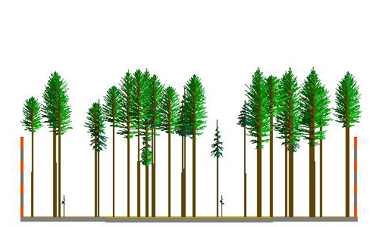
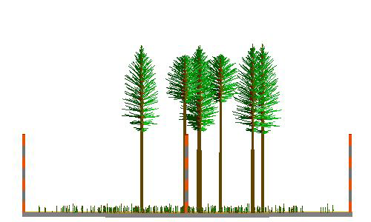
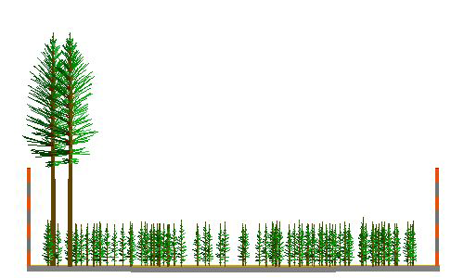
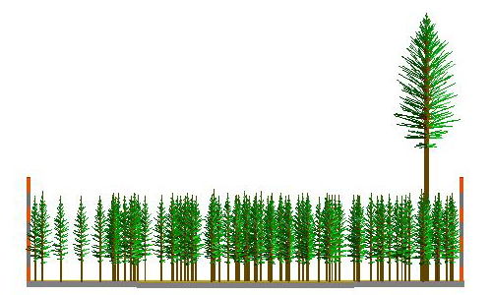
Stand Visualization of Sustainable Forest Management, Stand: 21153
2014 | 2024
2034 | 2044
Notes:
As you can see forest

Slide 12
Carbon Calculations Shannon A. Armitage & Brooke Cassell

Slide 13
Carbon Calculations
Landscape Management System (LMS)
Developed by University of Washington
Simulates forest growth under forest management prescriptions

Slide 14
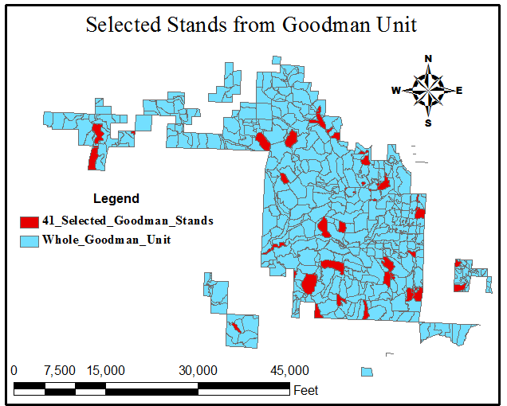
Carbon Calculations
Landscape Management System (LMS)
10% Random Sample
(41 stands out of 411)

Slide 15
Carbon Calculations
Landscape Management System (LMS)
10% Random Sample
(41 stands out of 411)
Ran many types of simulations and settled on three realistic possibilities

Slide 16
Carbon Calculations
Landscape Management System (LMS)
10% Random Sample
(41 stands out of 411)
Ran many types of simulations and settled on three realistic possibilities
Projected forest growth for 30 years, which should prevent too much error from the model

Slide 17
Carbon Calculations
Landscape Management System (LMS)
10% Random Sample
(41 stands out of 411)
Ran many types of simulations and settled on three realistic possibilities
Projected forest growth for 30 years, which should prevent too much error from the model
Multiply by 10 for total unit carbon

Slide 18
Carbon Calculations
Excel-based Carbon Calculator
(Browne, J.E. 1962)
(U.S. Forest Products Laboratory, 1974)
(Gholz, H.L. et al., 1979)
Carbon computed for trees only
Stems
Roots
Branches
Foliage
Not including soil or understory vegetation

Slide 19
To get our baseline carbon...
ACTUAL DATA:
411 plots
18,862.79 acres
2004 ~ 277.77 acres clear cut (1.5%)
2009 ~ 270 acres clear cut (1.4%)
SIMULATED DATA:
41 plots (10%)
1,922 acres (10.2%)
2004 ~ 29.12 acres clear cut (1.5%)
2009 ~ 27.41 acres clear cut (1.4%)
Then we simulated growth to 2014

Slide 20
Where are we now?
2009: 5,355,371 metric tons CO₂e
2014: 6,140,677 metric tons CO₂e
Annual Uptake Rate
157,061 Mg CO₂e / year

Slide 22
30 year Management Scenarios 2009 - 2039
Management Scenario | Average Annual Carbon Uptake (Mg CO2e) | Average Annual Timber Revenue | Range of Annual Timber Revenue
1. Baseline | 127,157 | $35,343 | $10,500 – $58,000
2. No Management | 151,659 | $0 | $0
3. Sustainable Forest Management | 99,646 | $28,749 | $16,000 - $57,000

Slide 23
A Few Considerations
Our simulations were run on a theoretical, homogeneous landscape based on average conditions across the Goodman Unit.
For truly accurate predictions, each stand will need to have an individual prescription based on its proximity to streams, potential for habitat, etc...
The model does not account for the extensive natural regeneration of western hemlock that occurs on the Olympic Peninsula, so the amount of carbon is likely underestimated.

Slide 24
Certification
Eric Snoozy & Gregg Zimmerman

Slide 25
Introduction to 3rd Party Certification
To officially claim offsets certification must be obtained
Certification process
Carbon Offset vs. Carbon Credit
Parties involved in certification
How to obtain forest certification

Slide 26
Certification Standards
Several Certification Standards:
Climate Action Reserve
American Carbon Registry
Climate, Community and Biodiversity Standards
Verified Carbon Standard
The Gold Standard

Slide 27
Project Types
To obtain certification a “project” must be created
In our case, the “project” would be the Goodman Unit
Improved Forest Management
Increases live standing carbon in forest
Employs natural forest management practices.
Afforestation, Reforestation, Revegetation
Creating new forests
Avoided Conversion
Stopping conversion to
Agriculture
Industrial
From peat swamps

Slide 28
Hurdles to Certification on the Goodman Unit
DNR cooperation
Land title or timber rights
Provide management plan(s) that meet requirements for “Natural Forest Management”
Continued monitoring each year (for 100 years)

Slide 29
Recommendation:
In order to count the Goodman unit as an offset it must be third party certified.
Our recommendation is to use the Climate Action Reserve certification standard. Although there are challenges to certifying this unit, certification should be considered for claiming offsets consistent with current guidelines.

Slide 30
WOOD BUILDINGS
Matt Grund & Mikhael Kazzi

Slide 31
Why Wood?
Carbon Smart
Energy Efficient
Potentially Costs less
Improves LEED ratings
Efficiently Reused and Recycled

Slide 32
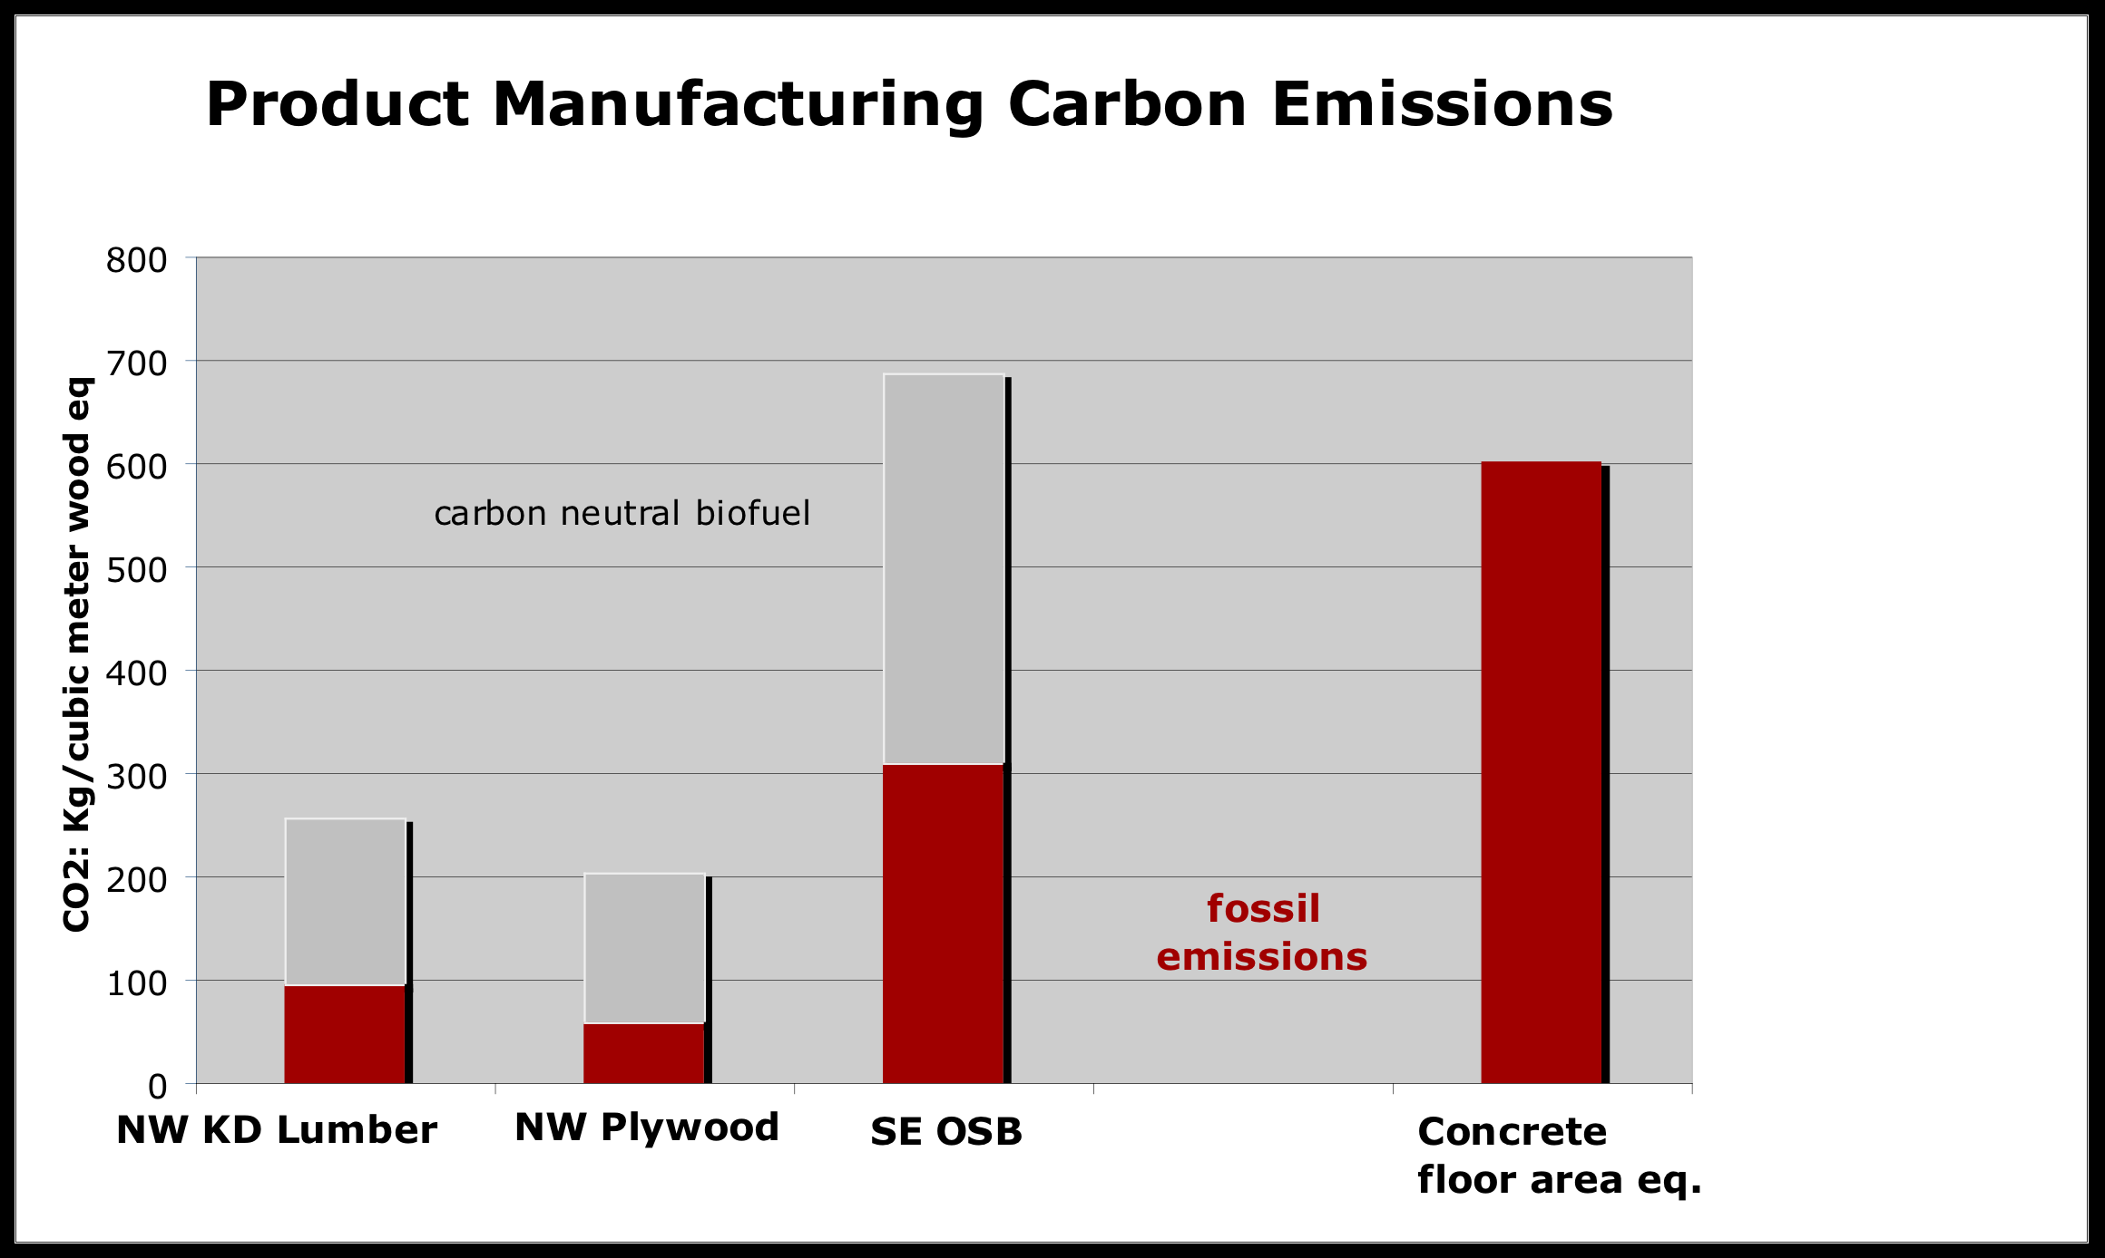
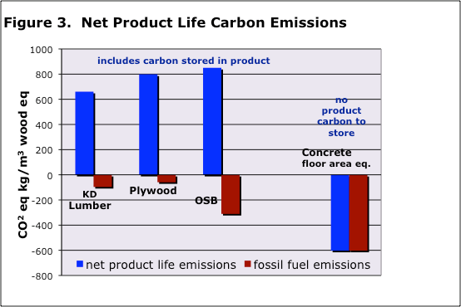
Wood is Carbon Smart
Stores enough C during lifetime to offset emissions from fossil-fuel intensive concrete
Requires significantly less energy to manufacture than steel and concrete
http://www.corrim.org/pubs/factsheets/fs_05.pdf
Notes:
Wood helps to minimize energy consumption in several ways. In terms of embodied energy, which includes the energy required to extract, process, manufacture, transport, construct and maintain a material or product, life cycle assessment studies (LCA) show that wood significantly outperforms both steel and concrete.
Lesser known is the fact that trees incorporate the absorbed carbon (C) into their wood, and products made from that wood, such as lumber and furniture, continue to store the carbon indefinitely. Because manufacturing processes associated with wood products require less energy,they are responsible for far less greenhouse gas emissions than materials such as steel or concrete.

Slide 33
Wood is a LEED-er
Building with wood improves LEED ratings
Resource Locality
Renewable Materials
Salvaged/Reusable Materials
Construction Waste Diversion
Low Emitting Materials
Notes:
Using wood as a primary construction material can potentially increase our LEED ratings with future buildings in the following categories. If we can harvest from the Goodman unit, we will certainly meet the resource locality standard, wood is a renewable material, there are many examples of buildings which have incorporated salvaged and reclaimed wood as a main construction material and it has proved to retain its strength, durability, and fire resilience. Wood is more efficiently recycled and reused than concrete or steel, which we will touch on a bit later, and most of the engineered wood products today contain very few VOC’s in their adhesives.

Slide 34
Energy Efficiency and Cost
Bethel School District
All schools built with wood frames
Energy Star rating of 81%
Several schools even achieved 95% - 98%
Wood allows over-insulation
Washington State Code
Steel/Concrete needs thermal break between exterior and interior walls
Thicker walls = More Cost
Wood is exempt!!

Slide 35
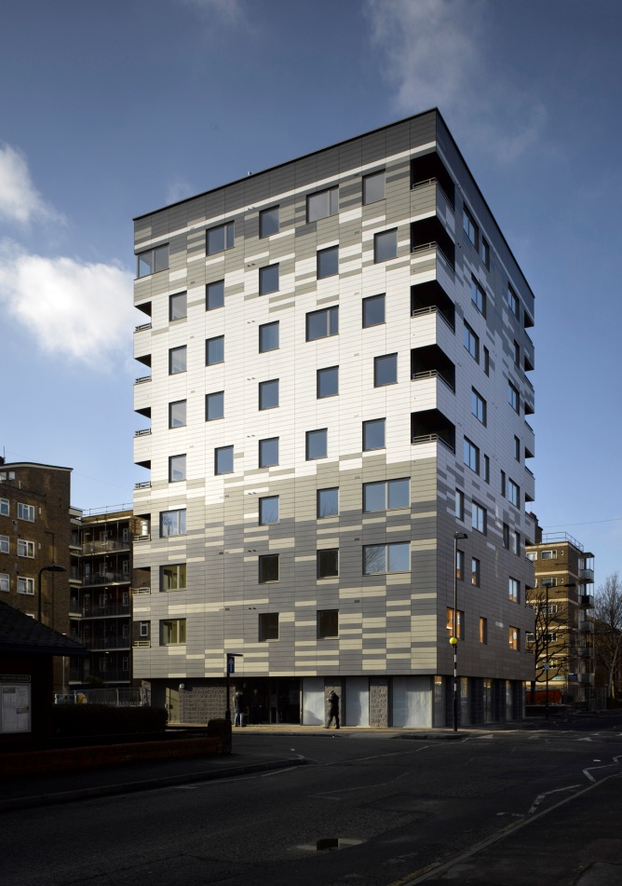
Cost and Carbon Savings
Stadthaus Complex
Costs 15% less than concrete/steel replicate
¼ the weight of concrete/steel
Lowers transport cost
Built w/ Cross-Laminated Timber
Significantly reduced construction process
Stores even more C than dimensional lumber
Positive C footprint for 20 years!

Slide 36
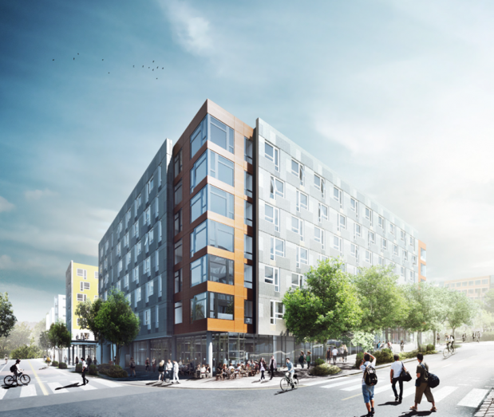
Case Study: Lander Hall
Total Emissions – 24,993 Mg CO2e
Concrete 12,375 tons
Steel 514 tons
Wood 688 tons (550 MBF)
95% of Lander is concrete and steel
5% of Lander is wood
Notes:
Just based on the construction materials

Slide 37
Lander Hall Carbon Emissions and Savings
naturally:wood* | 630 BF (1m³) Dimensional Lumber
Carbon Stored | +765 kg CO2e
Carbon Emissions (Harvesting, Manufacturing and Transportation) | -185 kg CO2e
Building Lifespan | Carbon Sequestered
50 years | +198 kg CO2e
75 years | +389 kg CO2e
100 years | +580 kg CO2e
Life-Cycle Assessment
PAS 2050 protocol
Full Carbon credit after 100 years (75% for 75yrs, 50% for 50yrs)
Lander emits..
50yr: 24,993 Mg CO2e
75yr: 24,826 Mg CO2e
100yr: 24,440 Mg CO2e
All Wood-Lander offsets..
50 yr: +2083 Mg CO2e
75 yr: +5370 Mg CO2e
100yr: +8655 Mg CO2e
Lander Hall | 550,000 BF Dimensional Lumber**
50 years | +173 Mg CO2e
75 years | +340 Mg CO2e
100 years | +506 Mg CO2e
*naturally:wood: Demonstrating Wood’s Carbon Benefits, Feb. 2011
**John Gilson of Walsh Construction; Troy Stahlecker of UW Capital Projects Office
Notes:
So I realize there’s a lot of numbers here, but let me tell you what to pay attention to. With the current wood…
According to the acclaimed wood research center, naturally:wood, we can see that the carbon stored in 1 cu. meter of softwood lumber is more than 3 times greater than the emissions from the harvesting, manufacturing, and transportation combined. The net carbon balance is based off of a 100 year global warming potential, meaning he full carbon savings can only be achieved if the building lasts 100 years. If it lasts 75 years, it will achieve 75% of its carbon savings, and in 50 years (which is the typical lifespan of a building), the wood in the building will achieve only half of its carbon savings potential.
We used the PAS 2050 standard of a 100 year global warming potential which provide sa consistent method and process for the determination of the life cycle GHG emissions associated with specific product or products.

Slide 38
Lander Emissions and Offsets Projections
Lander w/ 50 year lifespan is 90% wood to = Net Zero Carbon
>90% to achieve offsets
100 yr Lander w/ 62% wood
Increase Lifespan
Increase C Savings
Less wood for C offsets
Increase % Wood
Increase C Savings
Increase offsets in less time
Increase Lifespan and % Wood
Largest offsets
Most sustainable
Notes:
In the purple, we see the emissions from the current Lander with 5% of the building constructed from wood at the lifespan of 50, 75, and 100 years. As we can see, age does not make too significant of a difference in emissions at the 5% wood level. But the savings differences within the life-spans are clear once Lander is built using more wood.
Carbon savings become more pronounced within lifespan as % wood increases.
Able to reach net zero emissions with less wood if buildings have a longer lifespan
The net emissions from the construction of Lander are heavily dependent on the building’s lifespan as well as the amount of wood used in construction. Since wood stores more carbon than the combined carbon in its harvesting, manufacturing, and transportation, it is entirely feasible to achieve net zero emissions on buildings, where the increased use of wood and life cycle of the building account for the carbon debt created by up the fossil-fuel intensive construction materials, namely concrete and steel. Lander can achieve net zero emissions and even carbon savings. For a Lander with a 50 year life span, which is the typical lifespan of buildings, appx. 80% of its construction must use wood, for 75 year old Lander, it must be built with 60-65% wood and for a 100 year old Lander, a little more than half of its construction must be comprised of wood.

Slide 39
Conclusion
Alternatives of Goodman Unit Management
Carbon Calculations
Carbon Certification
Wood Buildings
Goodman unit area: ~7,700 hectares
Total Carbon:
1.9 million tonnes of Carbon
6 million mega grams of CO2 equivalence

Slide 40
Annual Goodman Unit Uptake & University Emissions
To Achieve Carbon Reduction of Building Materials:
Increase Life Span
Use Wood in Buildings

Slide 41
Acknowledgements
We would like to thank Dr. David Ford and Dr. Greg Ettl for their assistance with this project
As well as:
STARS
Jeff Cominick
Jason Cross
Guarrin Sakagawa
Dr. Rolf Gersonde
Dr. Elaine Oneil
Dr. Tom DeLuca
Troy Stahlecker
Walsh Construction

